Slide 1
Experiment summary
Goal: evolution of Prochlorococcus MIT9313 in co-culture with heterotrophic bacteria Alteromonas 1A3
Time series
Day 0
1 sample - axenic
Day 100
2 samples
Day 440
2 samples
Filter out 1A3 reads and map to mit9313 genome using bwa mem. Variant calling using freebayes.
Potential problem: Low coverage on 100 days samples.

Slide 2
Guidance needed
What is the recommended filtering of SNP?
How do you decide quality per sample
How do you compare different time points
We are sequencing a population and not a cloned colony - how to take it into account in the analysis?

Slide 3
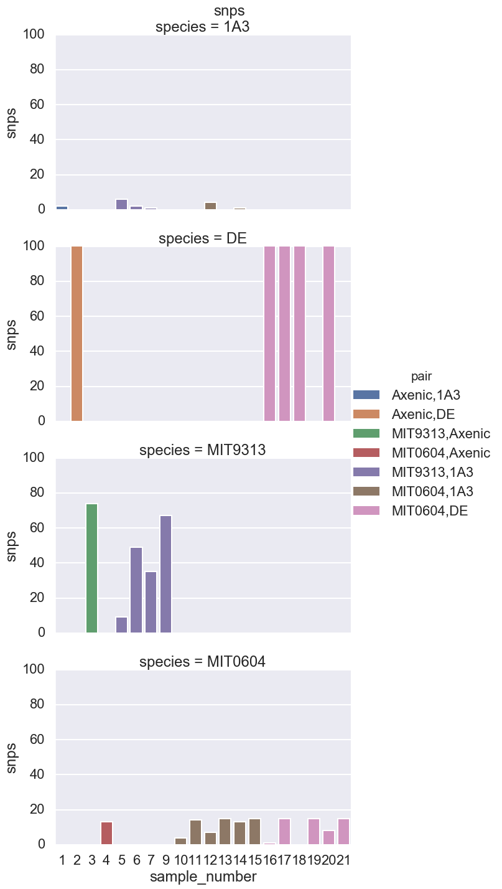
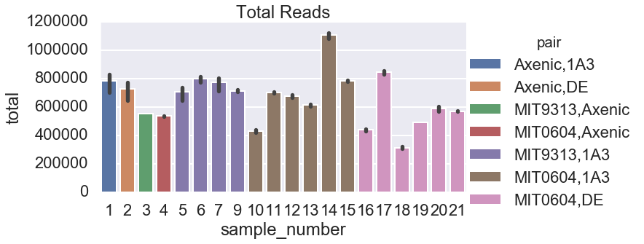
# | sample | PRO | ALT | exp | days | ng/ul | final volume
1 | Axenic | Axenic | 1A3 | 0 | 0 | 30 | 100
2 | Axenic | Axenic | DE | 0 | 0 | 10 | 100
3 | Axenic | MIT9313 | Axenic | 0 | 0 | 0.6 | 100
4 | Axenic | MIT0604 | Axenic | 0 | 0 | 6 | 100
5 | 2A | MIT9313 | 1A3 | 0 | 100 | 0.7 | 100
6 | 2A | MIT9313 | 1A3 | 6 | 440 | 1.2 | 100
7 | 2C | MIT9313 | 1A3 | 2 | 100 | 1.5 | 100
8 | empty | empty | empty | empty | empty | empty | empty
9 | 2C | MIT9313 | 1A3 | 6 | 440 | 8 | 100
10 | 5A | MIT0604 | 1A3 | 2 | 100 | 4.28 | 100
11 | 5A | MIT0604 | 1A3 | 6 | 440 | 16 | 100
12 | 5B | MIT0604 | 1A3 | 2 | 100 | 3.75 | 100
13 | 5B | MIT0604 | 1A3 | 6 | 440 | 7.3 | 100
14 | 5C | MIT0604 | 1A3 | 2 | 100 | 9.3 | 100
15 | 5C | MIT0604 | 1A3 | 6 | 440 | 19.3 | 100
16 | 10A | MIT0604 | DE | 2 | 100 | 5.85 | 100
17 | 10A | MIT0604 | DE | 6 | 440 | 14 | 100
18 | 10B | MIT0604 | DE | 2 | 100 | 1.6 | 100
19 | 10B | MIT0604 | DE | 6 | 440 | 6.25 | 100
20 | 10C | MIT0604 | DE | 2 | 100 | 5.34 | 100
21 | 10C | MIT0604 | DE | 6 | 440 | 18 | 100

Slide 4
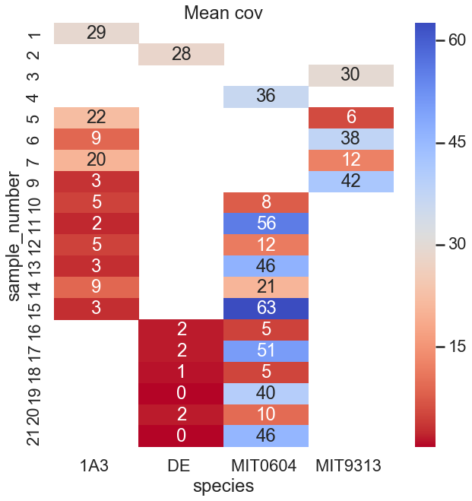
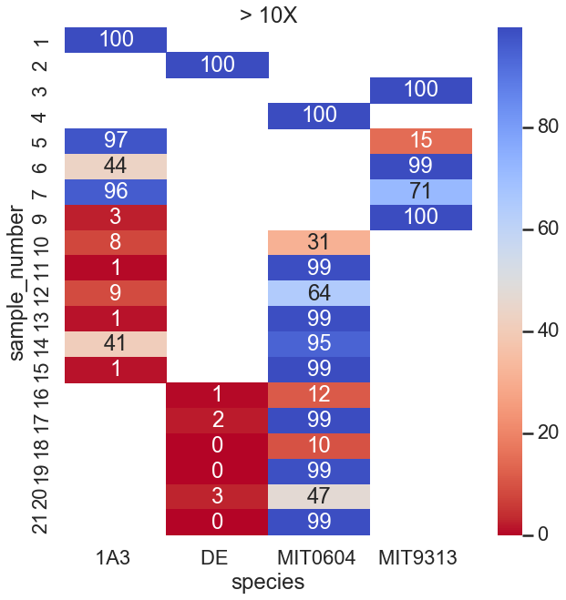

Slide 5
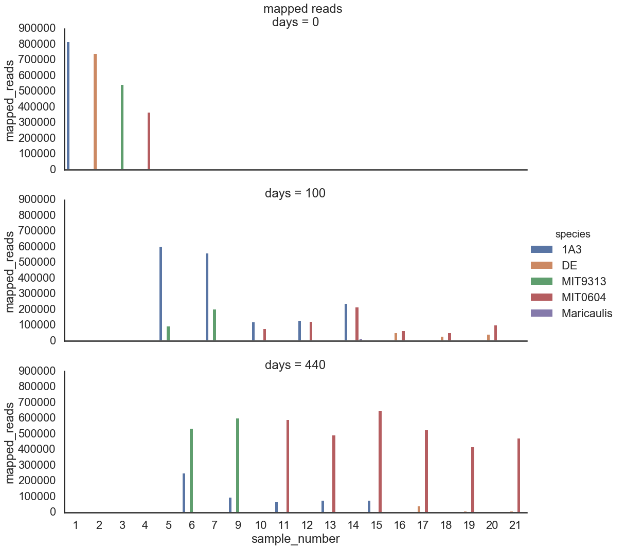

Slide 6
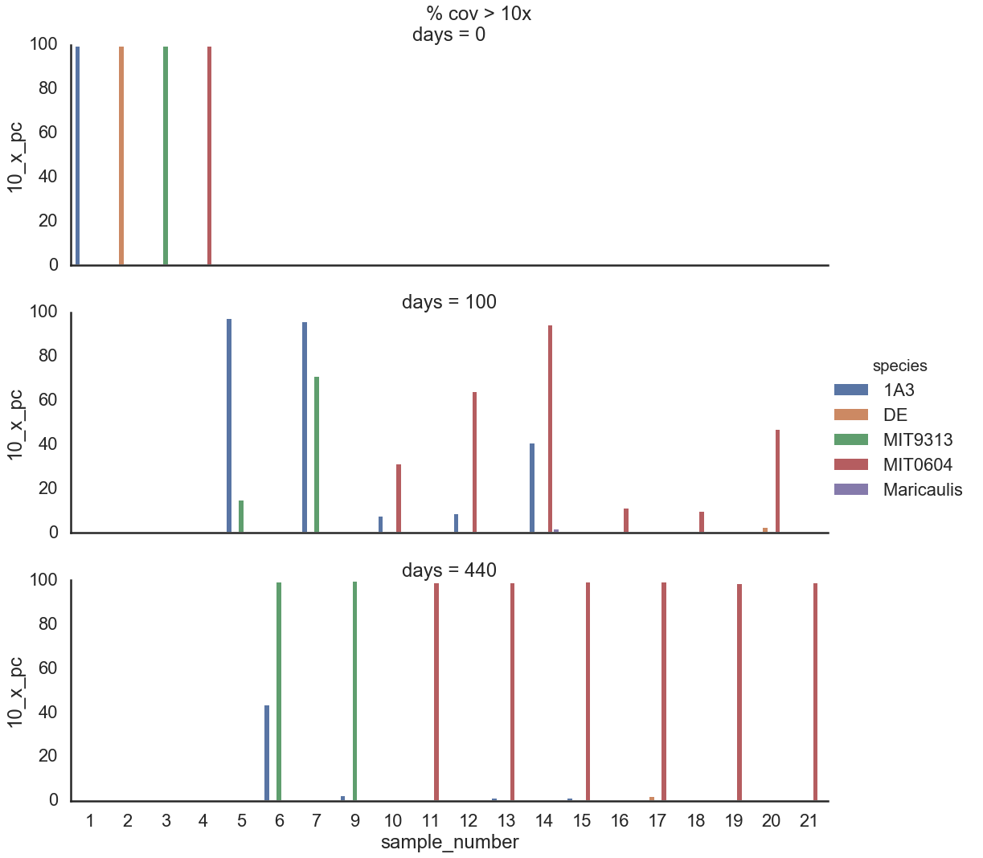

Slide 7
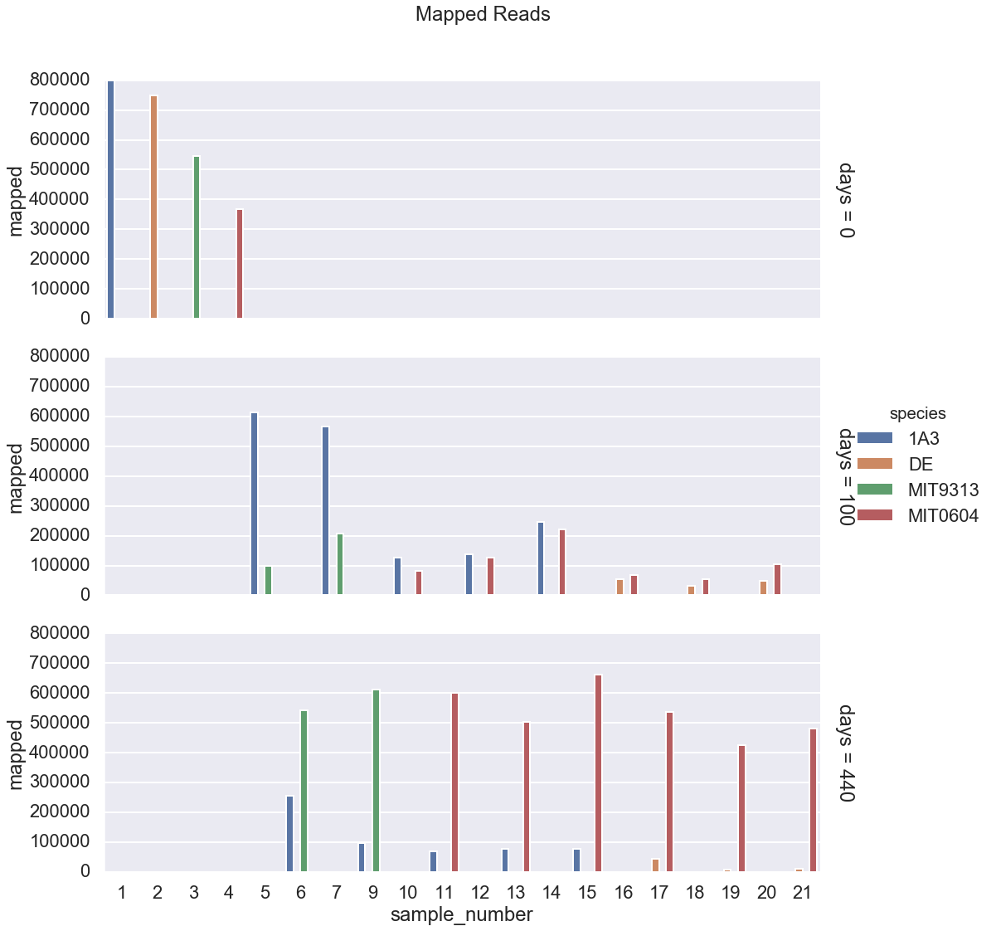
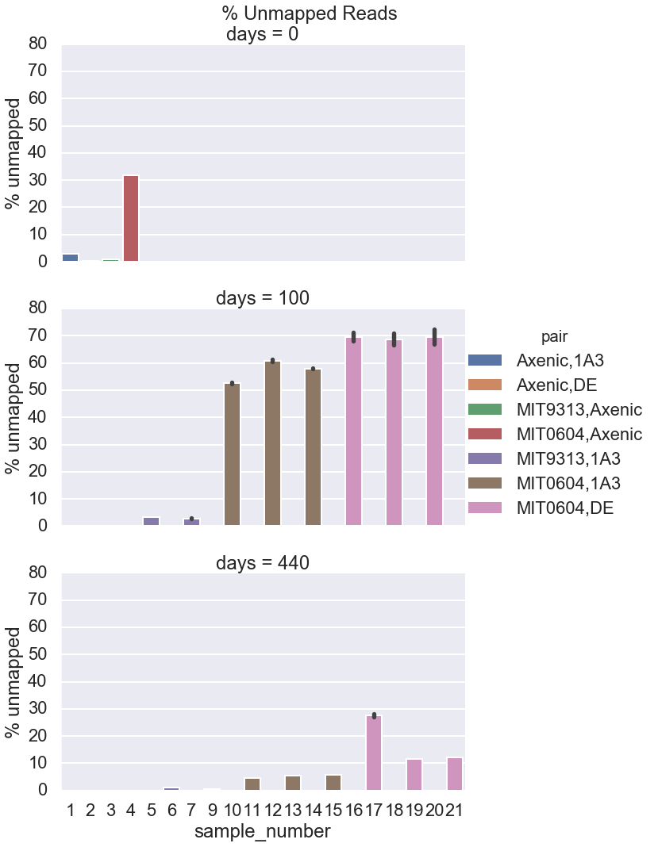

Slide 8
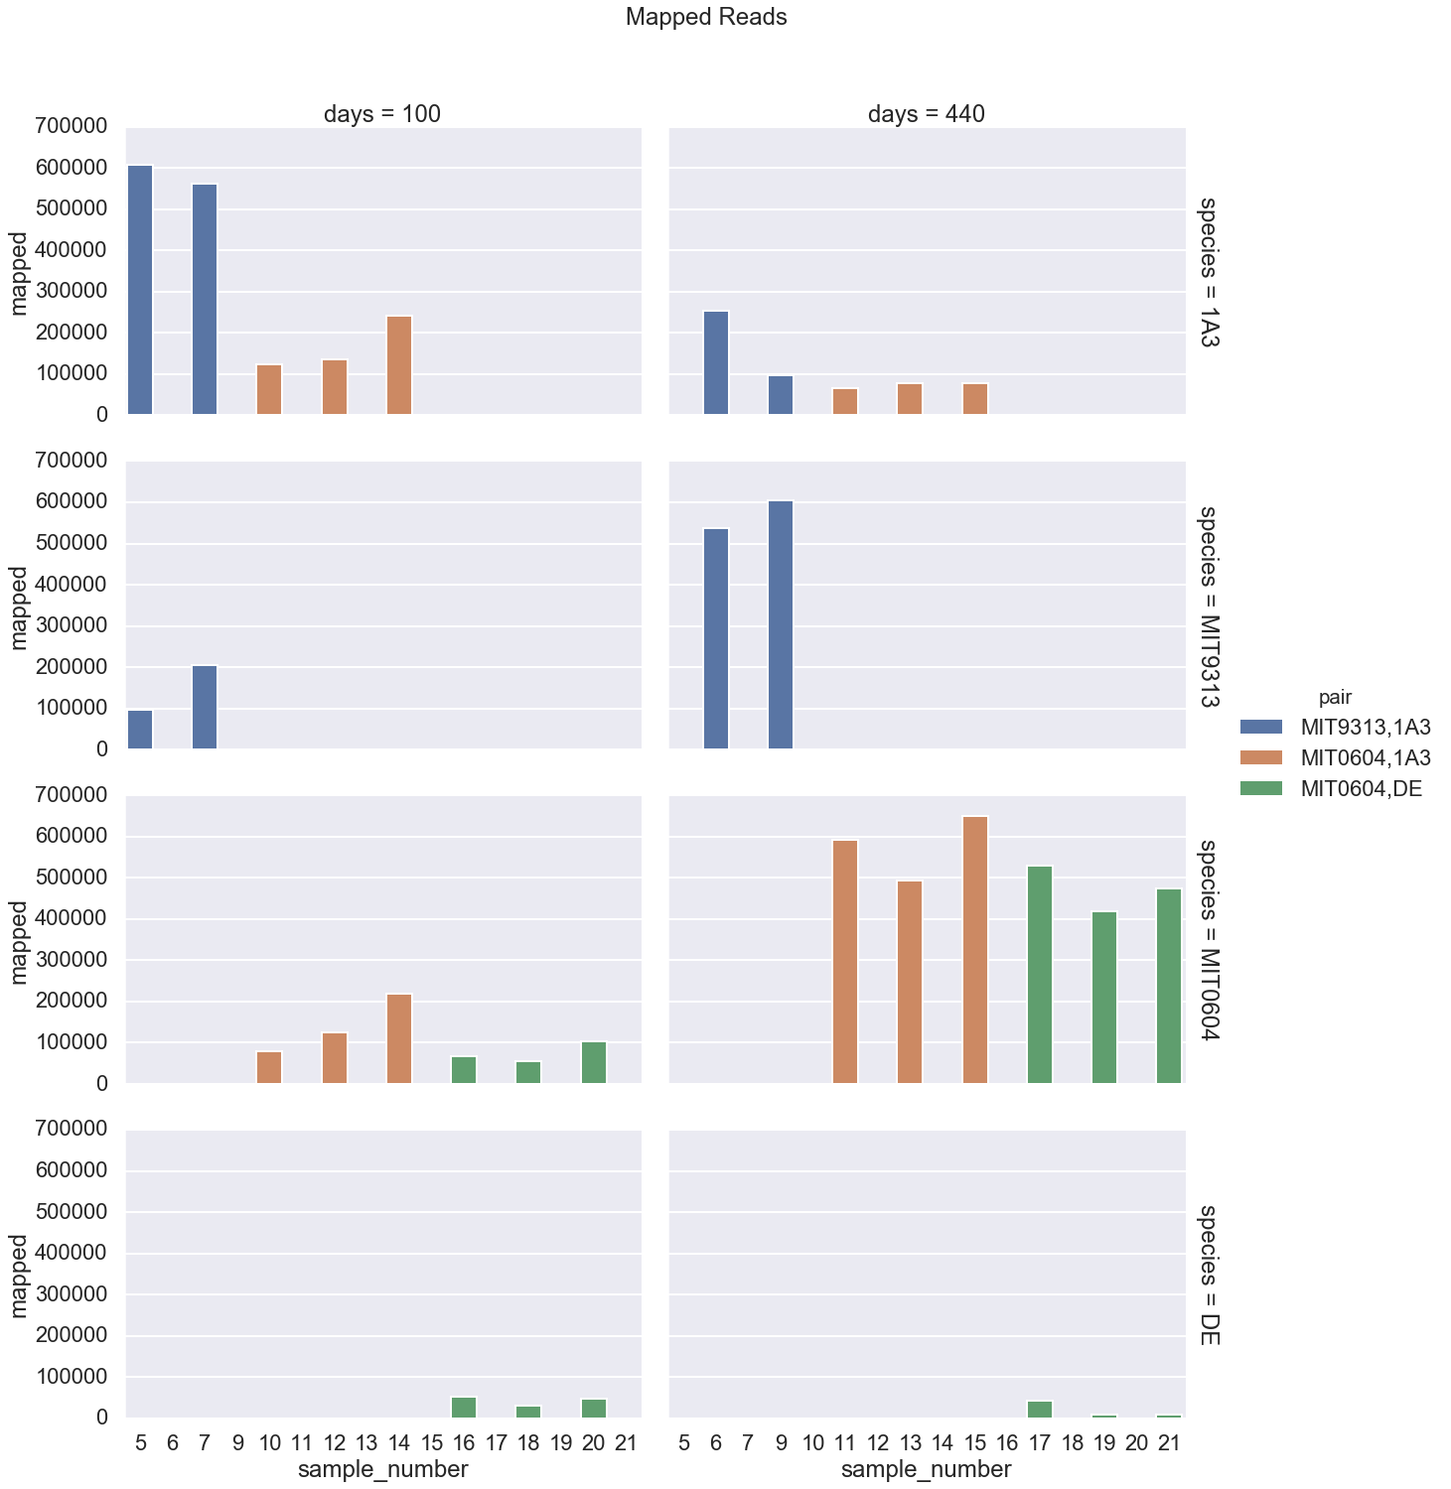
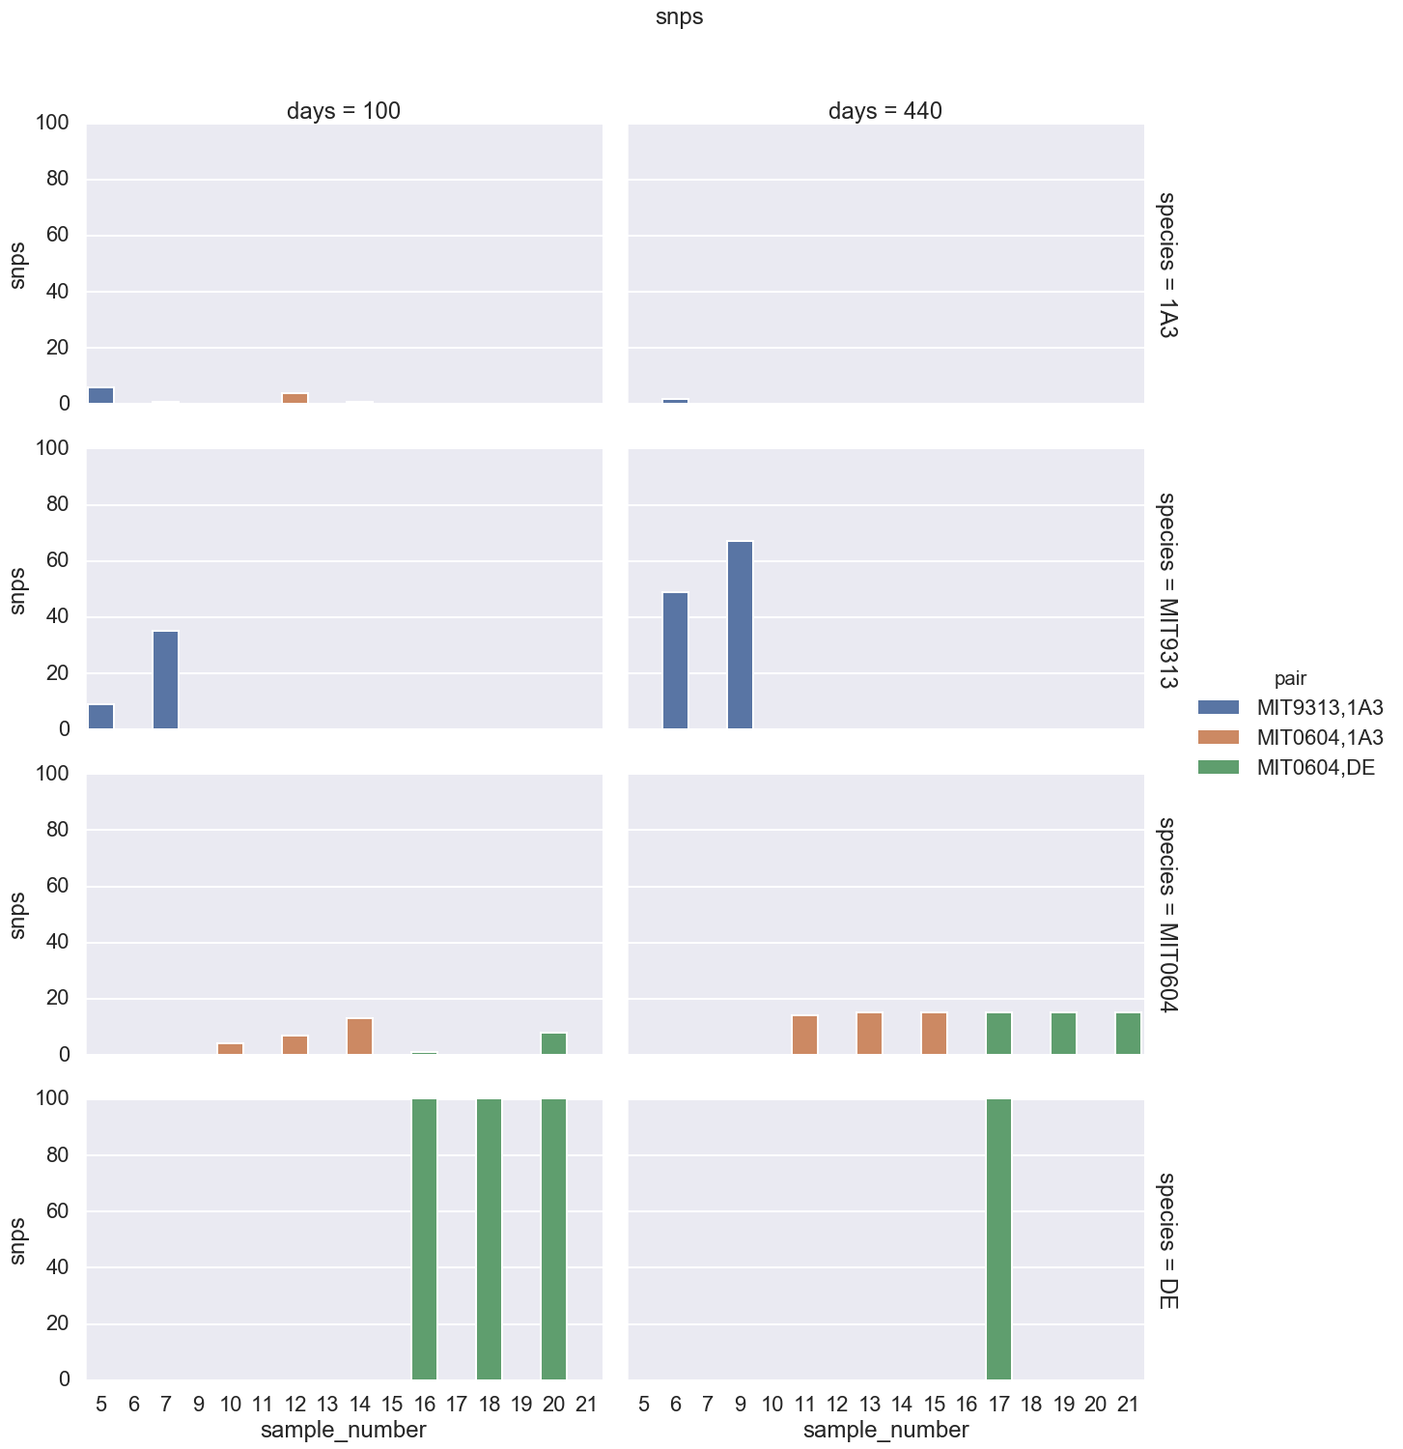

Slide 9
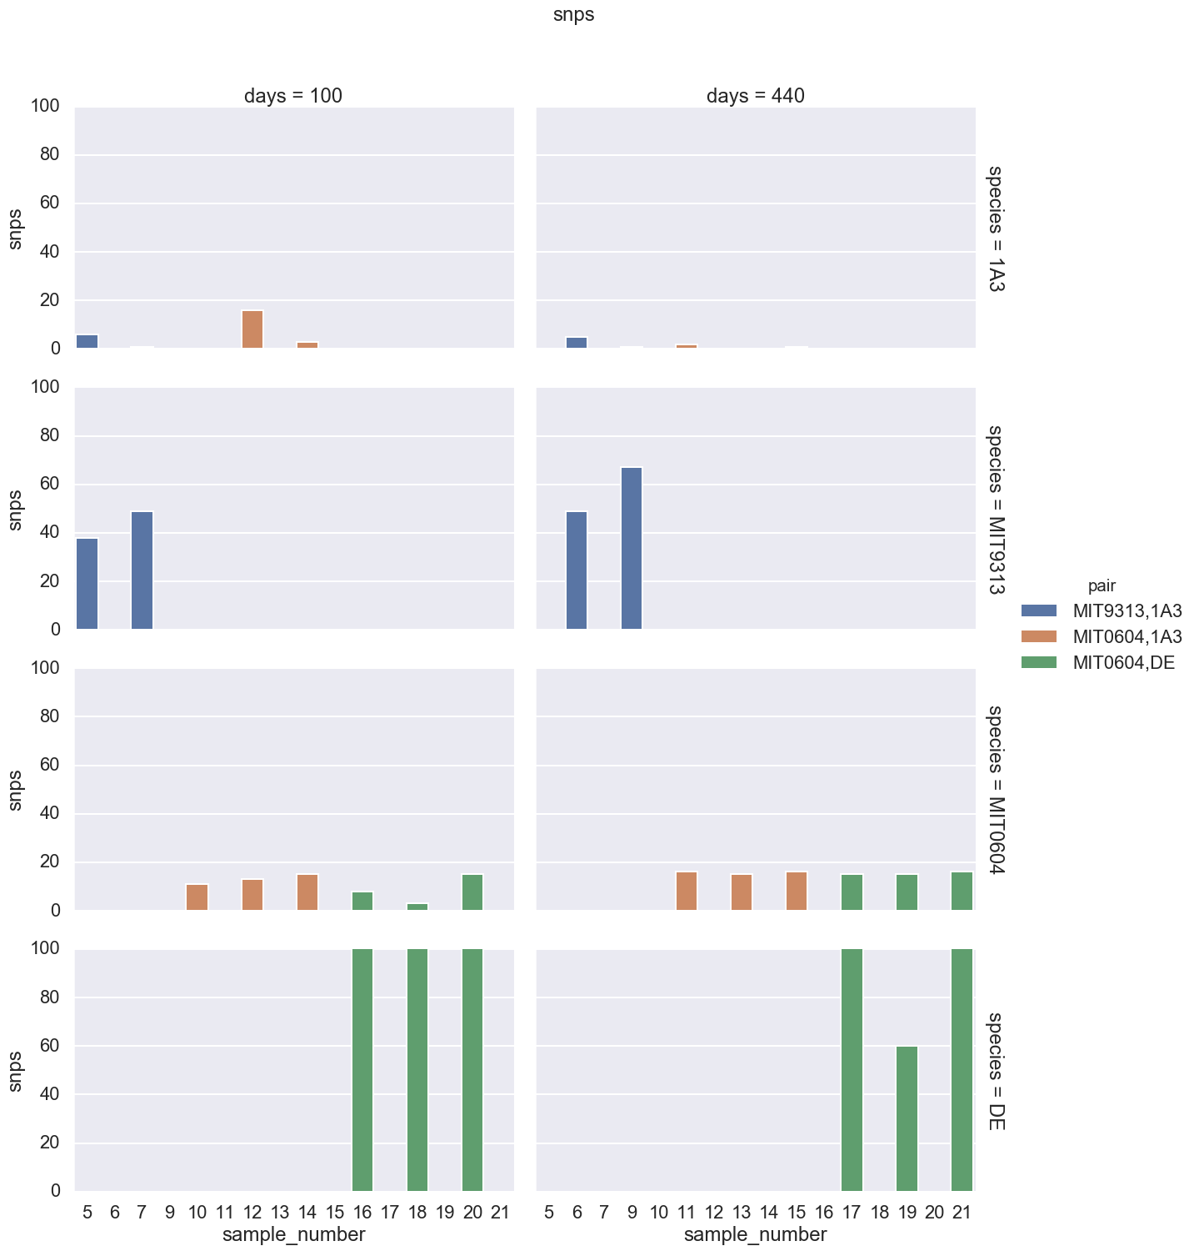
The variant calling is done by Freebayes. The key parameters under user control are:
--mincov - the minimum number of reads covering a site to be considered (default=10)
--minfrac - the minimum proportion of those reads which must differ from the reference
--minqual - the minimum VCF variant call "quality" (default=100)
Min coverage = 10
Min coverage = 5

